Slide 1
The Game With No Name
A Musical Typing Game

Slide 2
Script
The code consists of JavaScript, HTML, CSS, and PHP
Code was created and shared in Github

Slide 3
Design Choices
Color Scheme
Text choices
Game Flow

Slide 4
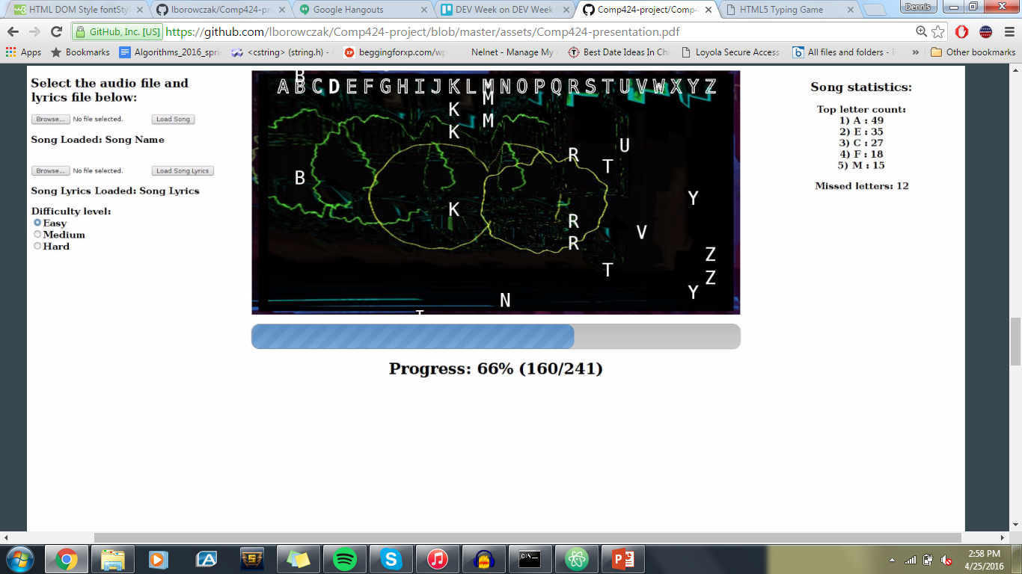
Dev Week Model

Slide 5
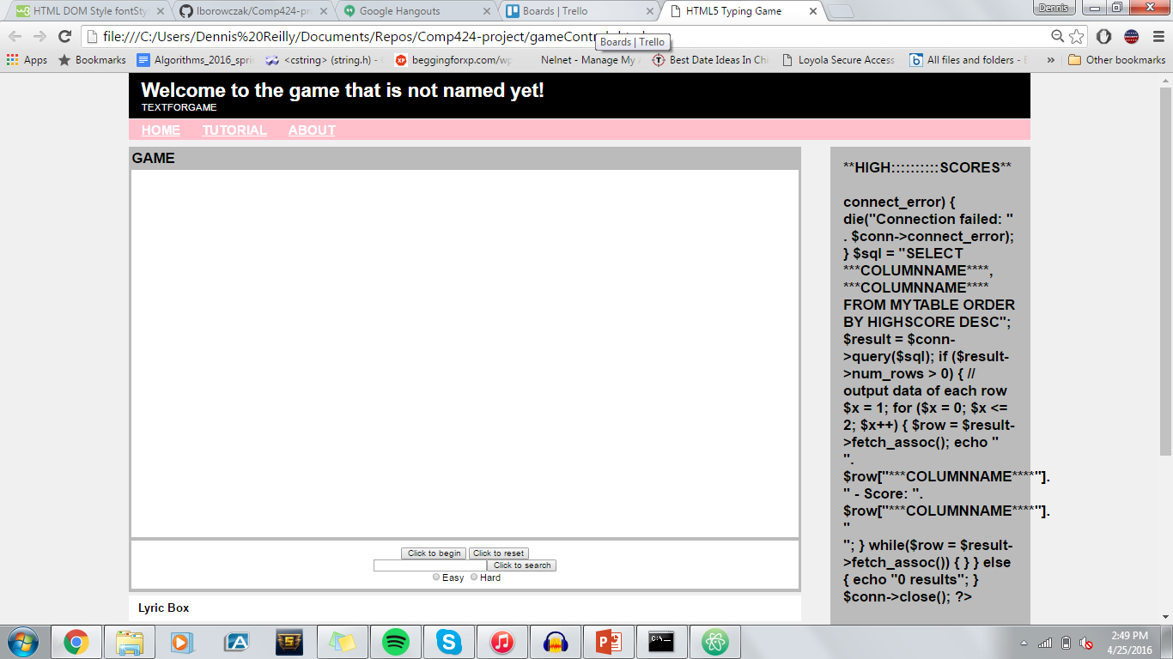
Updated Model

Slide 6
Cuts and Limitations
Design choices
Hardware limitations
User testing and Feedback

Slide 7
DEMO

